Slide 1


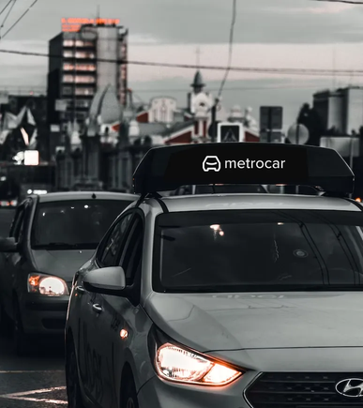
metrocar
METROCAR
FUNNEL ANALYSIS
OPTIMIZING THE CUSTOMER JOURNEY FOR METROCAR RIDE-SHARING APP
MASTERY PROJECT
CREATED BY DR.SVITLANA KOVALIVSKA
WITH THE STUDY PURPOSES
06/12/2024, MASTERSCHOOL, GERMANY
1

Slide 2
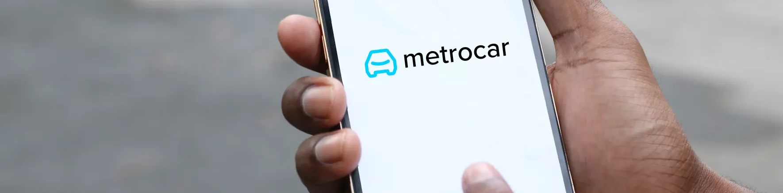
metrocar
Project Overview
About Service
Metrocar's business model is based on a platform that connects riders with drivers through a mobile application. Metrocar acts as an intermediary between riders and drivers, providing a user-friendly platform to connect them and facilitate the ride-hailing process.
This project aims to analyze Metrocar's customer funnel to identify drop-off points, optimize user retention, and provide data-driven recommendations for improving platform performance and customer engagement.
2

Slide 3
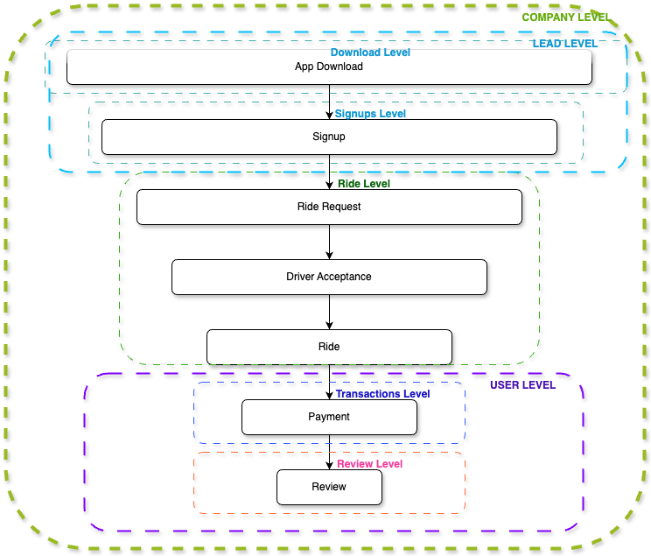
metrocar
Home
Photo
About Us
Contact
Metrocar Customer Funnel
Stages: App Download → Signup → Request Ride → Ride Accepted → Ride Completed → Payment → Review.
Key points:
Users drop off at every stage.
Optimizing each stage leads to higher revenue and user satisfaction.
01
02
03
04
05
06
07
3

Slide 4
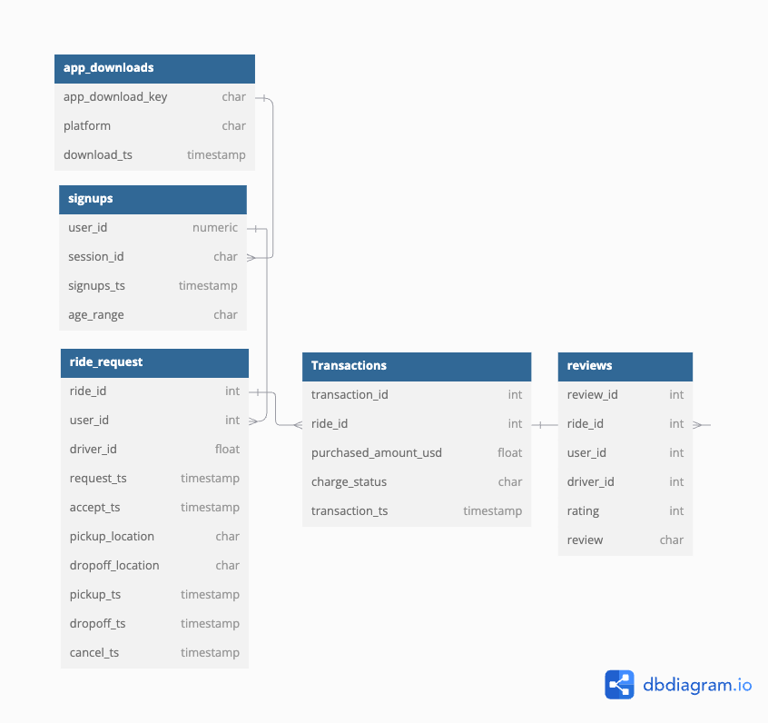
metrocar
Data Exploration and Methodology
Data Sources:
5 datasets: App Downloads, Signups, Ride Requests, Transactions, and Reviews.
Exploration Steps:
Merged datasets using unique keys.
Cleaned data to handle null values, duplicates, and inconsistent timestamps.
Conducted descriptive analysis to understand distributions and patterns.
Methodology:
Funnel construction: Tracked user progression through the funnel stages.
Conversion analysis: Measured drop-off rates using "Percent of Previous" and "Percent of Top" methods.
Segmentation: Analyzed performance by platform, age group, and time of day.
4

Slide 5
metrocar
Home
Photo
About Us
Contact
What Are We Solving?
Business Questions:
1._ Funnel Optimization:
Which stages of the funnel have the highest drop-offs?
How can we improve conversion rates at these stages?
2. Platform Performance:
Which platform (iOS, Android, Web) performs best, and where should we focus our marketing budget?
3. Age Group Insights:
Which age groups perform best at each funnel stage?
How can we better engage underperforming demographics?
4. Surge Pricing Analysis:
How do ride requests distribute across different times of the day?
Is surge pricing a viable strategy for Metrocar?
5. Overall Conversion Improvement:
What specific steps can be taken to improve the lowest-performing parts of the funnel?
01
02
03
04
04
05
5

Slide 6
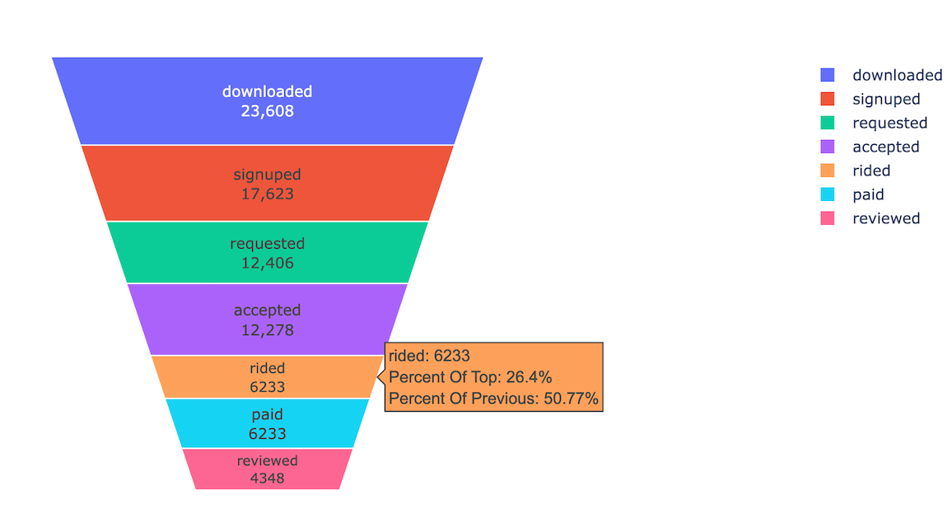
metrocar
BQ: Funnel Optimization
01
Funnel Analysis Overview
Key Metrics:
Total Downloads: 23,608 users entered the funnel.
Signups: 74.68% conversion from downloads.
Ride Requests: 70.4% conversion from signups.
Ride Accepted: 98.97% acceptance rate.
Rides Completed: 6,233 rides completed (50.7% conversion from requests).
Paid Rides: 100% of completed rides were paid.
Reviews: 4,348 users left reviews (69.8% of riders).
6

Slide 7
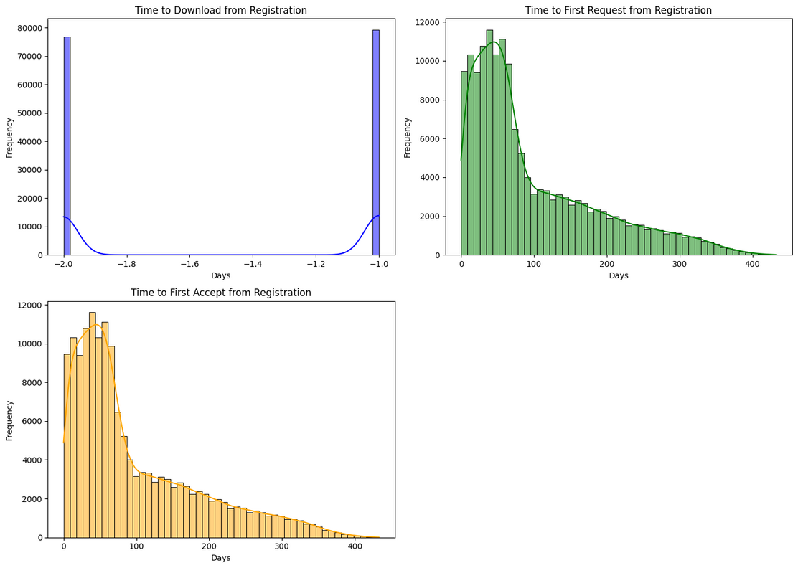
metrocar
BQ: Funnel Optimization
01
Analysis of Time Between Registration and First Use: Impact of 1 and 2 Day
Conclusions:
Time Distribution: Most users start using the app within 1-2 days after registration, indicating strong initial interest.
Importance of Prompt Activation: Quick user activation is crucial for long-term engagement.
Recommendations:
Intensify Communication: Increase marketing efforts in the first days to encourage immediate use.
Simplify Activation: Streamline the onboarding process to boost early engagement.
Enhance First Use Experience: Optimize the initial user experience to encourage continued use.
7

Slide 8
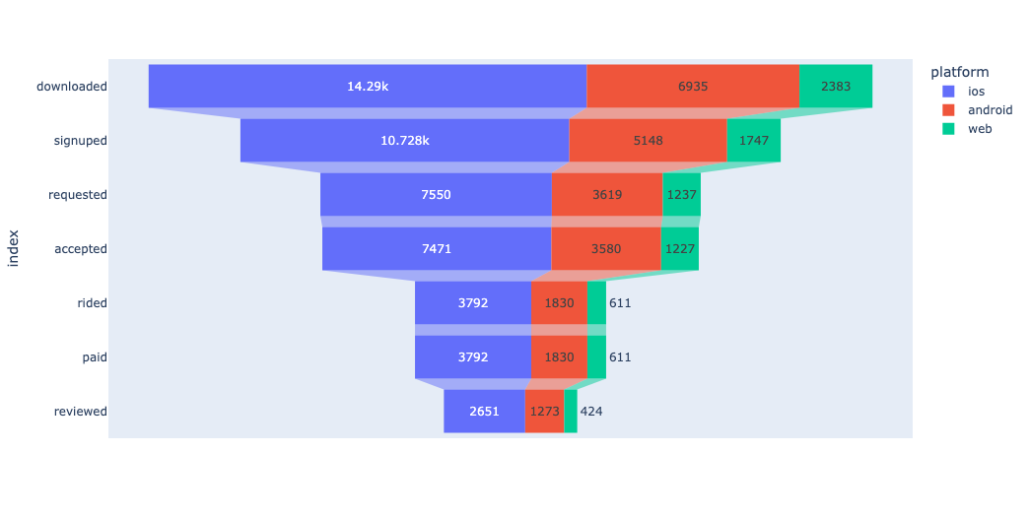
metrocar
BQ: Platform Performance
02
Conversion Rates Across Platforms
Highlights:
iOS leads in downloads and conversions but performs similarly to Android in drop-off rates.
Web has the smallest user base and slightly lower conversion rates.
8

Slide 9
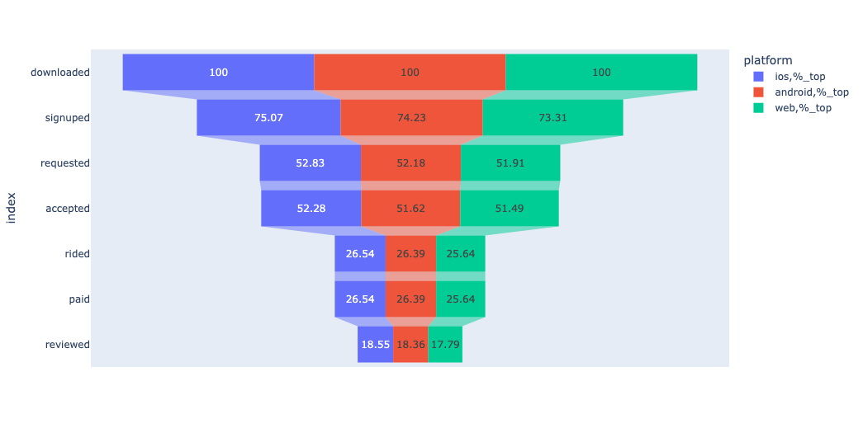
metrocar
BQ: Platform Performance
02
Conversion Rates Across Platforms
Highlights:
All platforms show similar and relatively high retention.
potential issue with user engagement or app flow from signup to ride request.
Paid: Matches ride completion
Reviewed: Significant drop-offs after the ride:
iOS: 18.55% of all downloaded users leave a review.
Android: 18.36%.
Web: 17.79%.
Key Metrics:
Critical Drop-Off: Ride Stage iOS: Only 26.54% of users who download the app complete a ride.
Android: 26.39%.
Web: 25.64% (lowest).
9

Slide 10
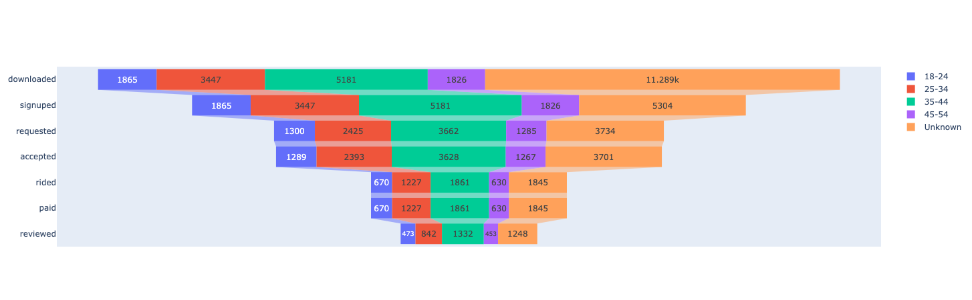
metrocar
BQ: Age Group Insights
03
Insights:
25-34 Age Group:
Highest engagement, from signup to leaving reviews.
35.6% of all users who downloaded the app fall in this group.
18-24 Age Group:
Smaller user base but strong performance in leaving reviews (70.6% review-to-ride ratio).
Fluctuating engagement across other funnel stages.
35-44 Age Group:
Solid mid-range performance, with steady drop-offs through the funnel.
45-54 Age Group:
Higher drop-offs post-signup, with only 34.5%
of downloaded users completing a ride.
Unknown Age Group:
Large proportion of users with missing age data.
Age Group Performance Across the Funnel
Learn More
10

Slide 11
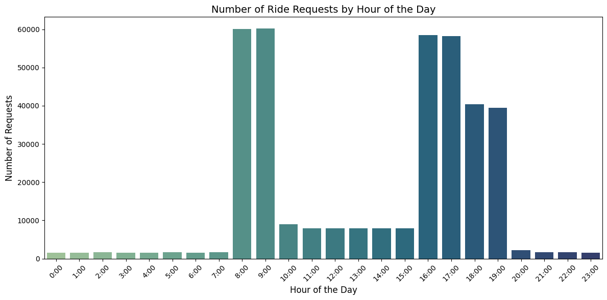
metrocar
BQ: Surge Pricing Analysis
04
When Are Ride Requests Highest?
Morning Peak: Highest ride requests occur between 8–9 AM, likely due to commuters heading to work or school.
Afternoon Peak: Requests surge again from 4–5 PM, coinciding with end-of-day activities.
Evening Demand: Elevated requests persist from 6–7 PM, likely driven by leisure activities and late commutes.
Learn More
11

Slide 12
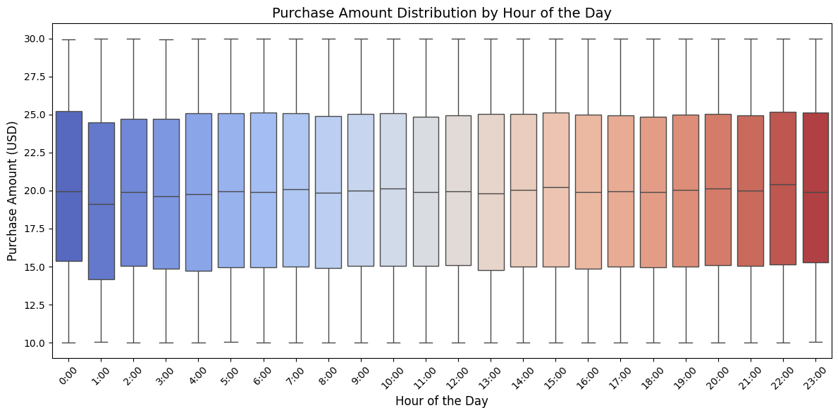
metrocar
BQ: Surge Pricing Analysis
04
Price Distribution Remains Stable
The average ride price remains consistent around $20 across all hours of the day, showing no correlation between demand peaks and pricing.
Age groups also display minimal variance in price sensitivity, with similar distributions across cohorts.
Learn More
12

Slide 13
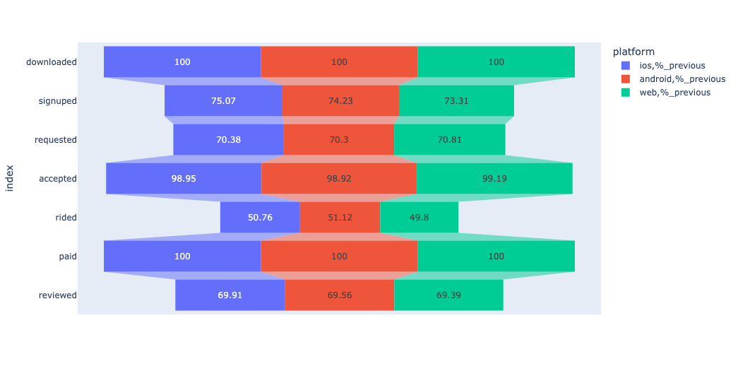
metrocar
BQ: Overall Conversion Improvement
05
Biggest Drop-Off Point: Request to Ride
Key Insight:
Focus on improving the Request-to-Ride completion stage for all platforms, especially Web.
Ride Completion - Bottleneck stage across all platforms:
Major drop: Android (51.12%), iOS (50.76%), Web (49.80%).
About 70% of riders leave reviews, with Web slightly behind.
Learn More
13

Slide 14
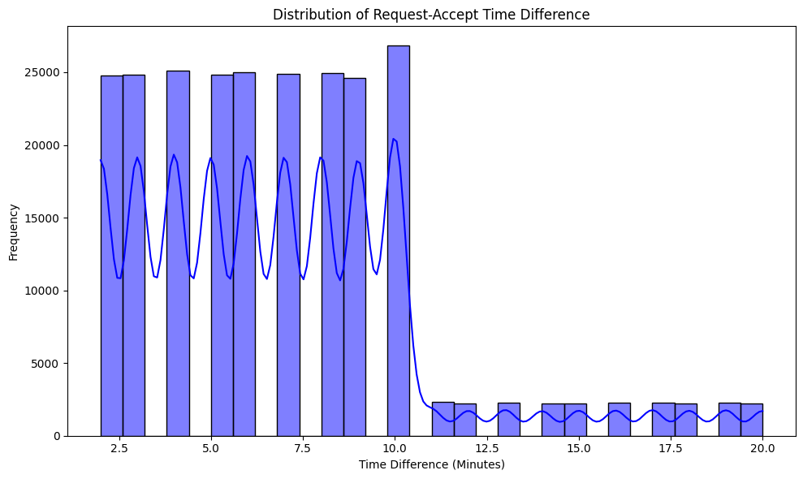
metrocar
BQ: Overall Conversion Improvement
05
Drop in Accept-Pickup Time After 10 minutes
Potential issues:
Driver Delays: Longer driver response times may result in unaccepted rides, as users lose patience.
User cancellations: Users might be canceling their requests if they don't get a timely response, especially if they experience longer than expected wait times.
Operational Inefficiencies: There may be issues with the matching process or system delays preventing faster responses.
14

Slide 15
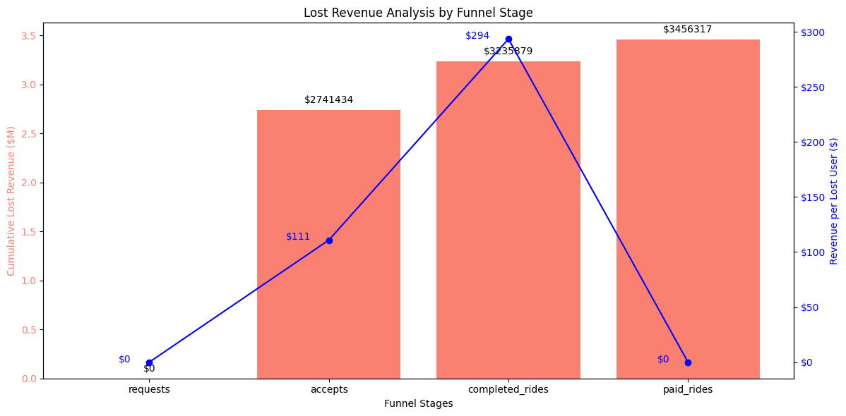
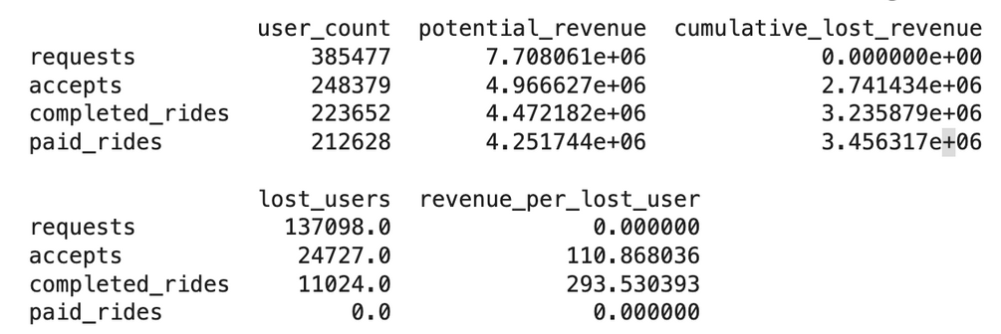
metrocar
BQ: Overall Conversion Improvement
05
Advanced Analysis: Potential loses
Potential revenue losses:
At the requests stage, potential revenue is $7.7M.
By the accepts stage, it drops to $4.97M, with a loss of $2.74M.
By completed rides, revenue decreases further to $4.47M, with a total loss of $3.24M.
At the paid rides stage, potential revenue is $4.25M, with a total loss of $3.46M.
Potential revenue per lost user rises as the funnel progresses:
At the accepts stage, it reaches $110.87.
By completed rides, it increases to $293.53.
15

Slide 16
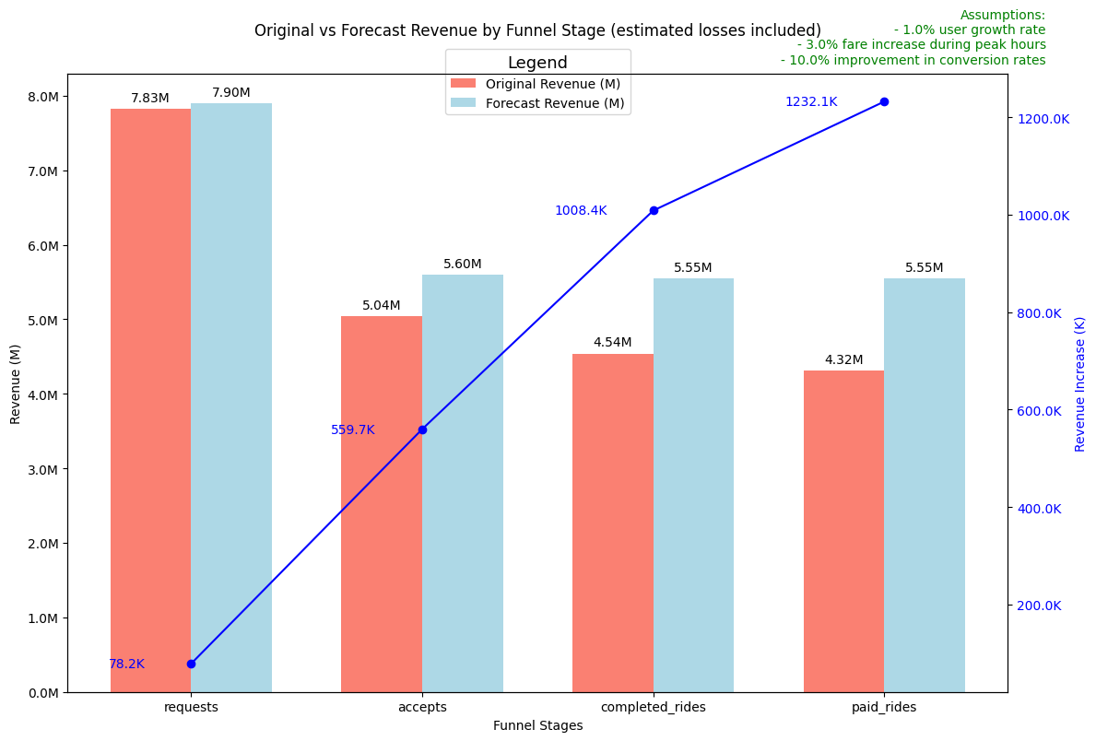
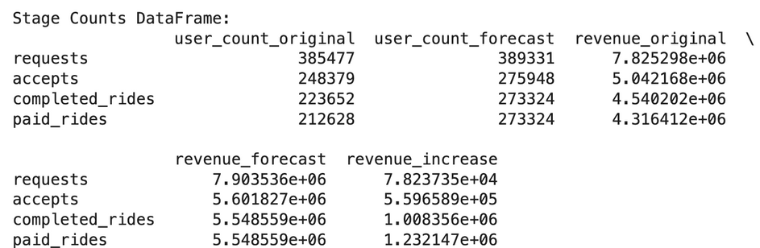
metrocar
BQ: Overall Conversion Improvement
05
Advanced Analysis: Forecast
The model forecasts an increase in Paid Rides as follows:
• Original Paid Rides: 212,628
• Forecasted Paid Rides: 273,324 (increase of 60,696)
• Original Revenue: $4.32 million
• Forecasted Revenue: $5.55 million (increase of $1.23 million)
This reflects the impact of assumptions like user growth, fare adjustments, and conversion improvements on revenue from paid rides.
16

Slide 17
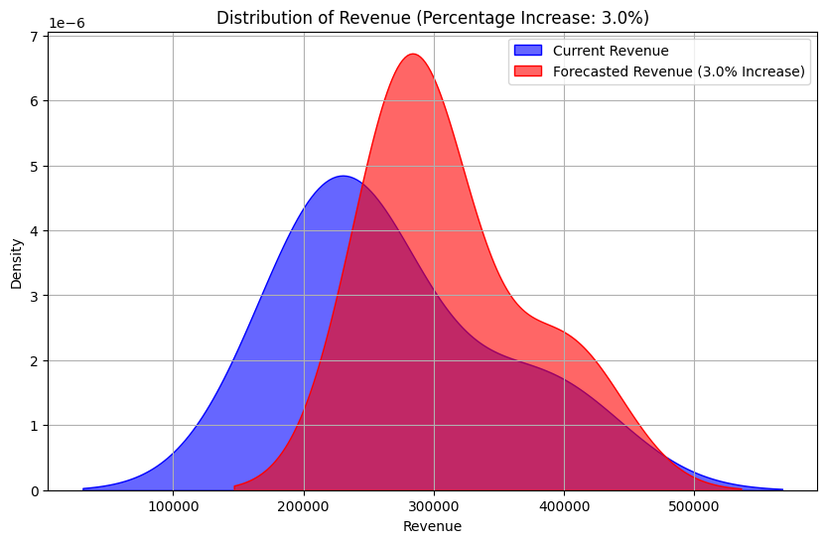
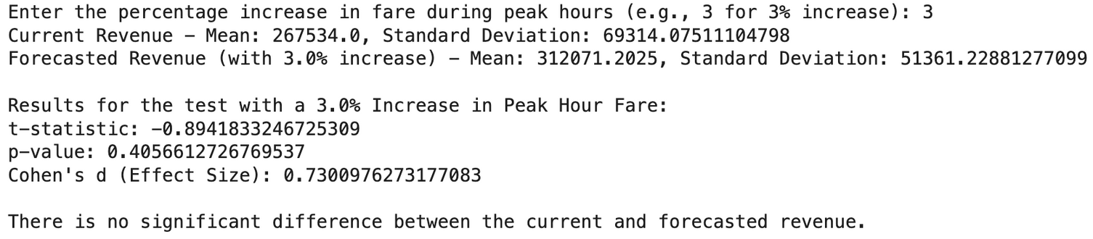
metrocar
BQ: Overall Conversion Improvement
05
Advanced Analysis:
A/B Test
Conclusion:
The test shows no significant difference between the current and forecasted revenue.
This confirms that the model based on the assumptions of lost revenue accurately reflects the real data, validating its use for decision-making.
17

Slide 18
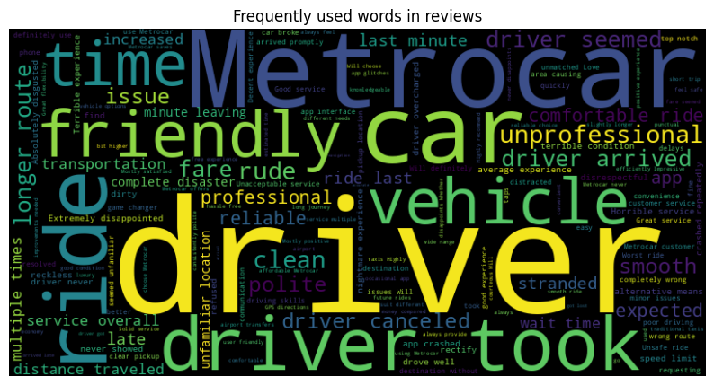
metrocar
BQ: Overall Conversion Improvement
05
Optimizing the Metrocar Funnel
01
Platform Insights: Invest more in iOS and Android; revamp Web UX.
Demographics: Prioritize the 25-34 age group; improve accessibility for 45+.
Bottlenecks: Optimize driver response times and reduce Request-to-Ride drop-offs.
Surge Pricing: Implement during commuting and weekend peaks.
02
02
02
03
04
0
18

Slide 19

metrocar
THANK YOU
GITHUB.COM/KOVALIVSKA
19

